Slide 1
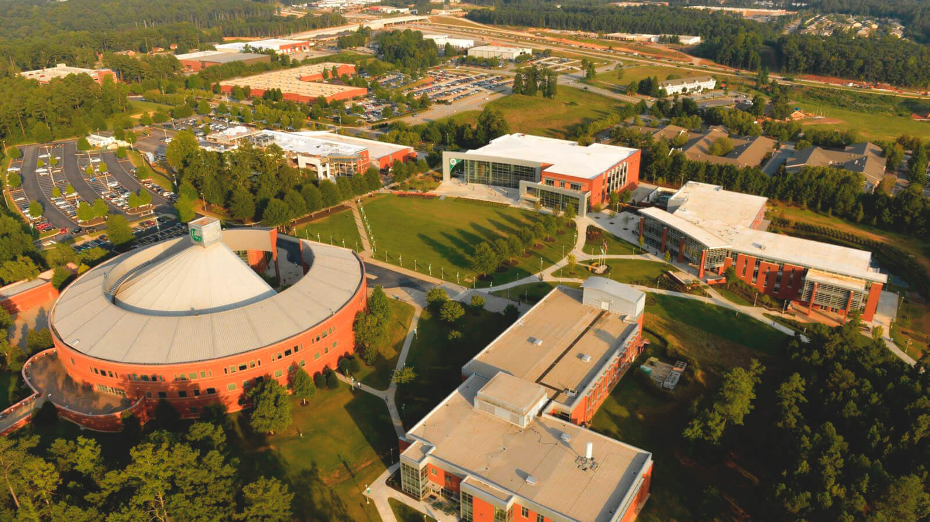
An Approach to Identifying the Skills of IT Concentrations
By: Anel Coralic, Sam Downs, Ashley Mendez

Slide 2
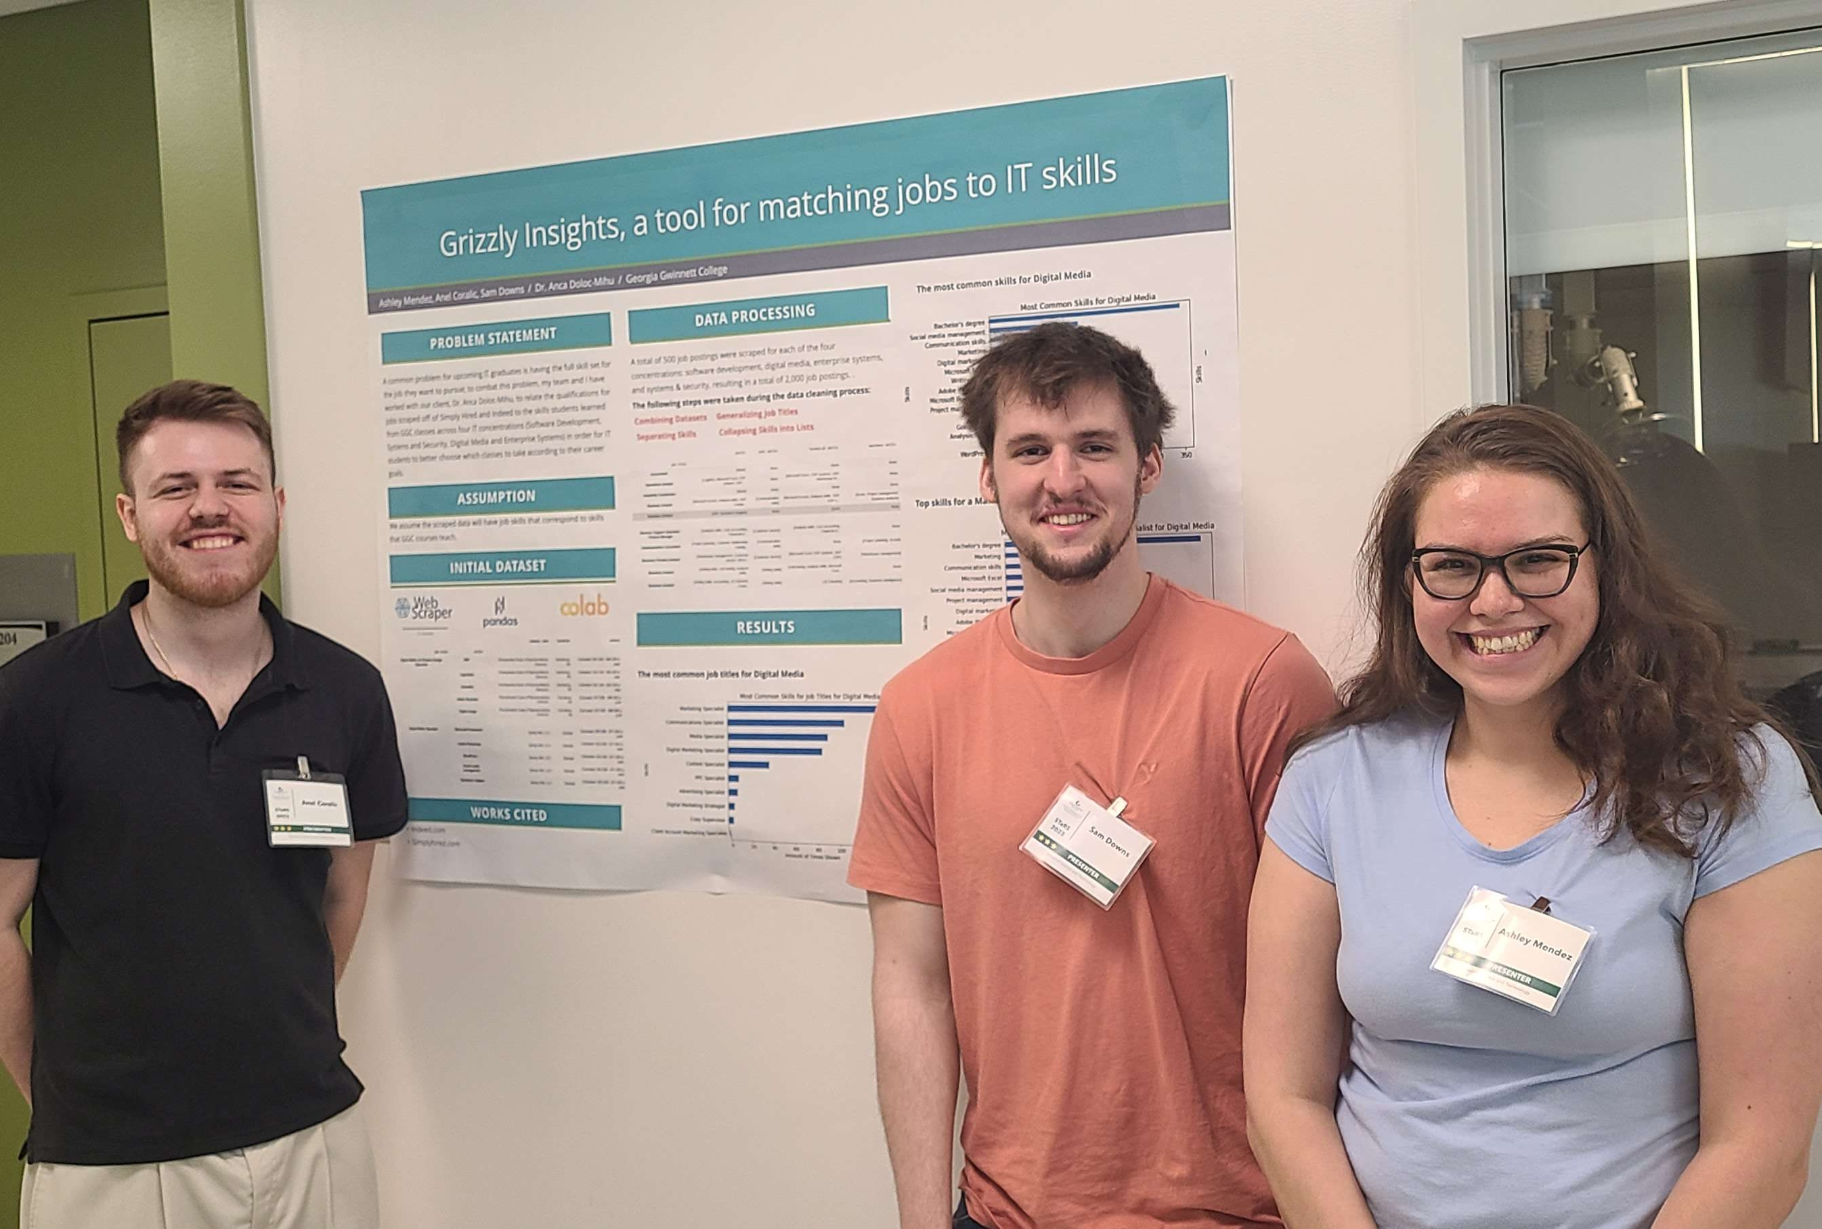
Team Members
Anel Coralic: Data Analyzer/Team Manager
Sam Downs: Data Modeler/Project Documenter
Ashley Mendez: Data Visualizer/Client Liaison

Slide 3

Our Client
Dr. Anca Doloc-Mihu
Associate Professor of Information Technology at Georgia Gwinnett College
Educates college students about Data Science tools and technologies

Slide 4

Project Description
This project aims to help GGC students choose courses that align with their career goals.
We improved the Grizzly Path website using data collected from job sites
We identified in-demand skills with a goal to match them to GGC courses.
This will enable students to make more informed decisions about their academic pursuits.

Slide 5










Technologies Used

Slide 6
Methodology
First Iteration: Collected data from job search websites, specifically Indeed and Simply Hired, by utilizing a Web Scraper extension.
Second Iteration: Datasets were cleaned by performing generalization, separating skills, and combining them.
Third Iteration: Analyzed the data and visualized the data using the Grizzly Path website

Slide 7
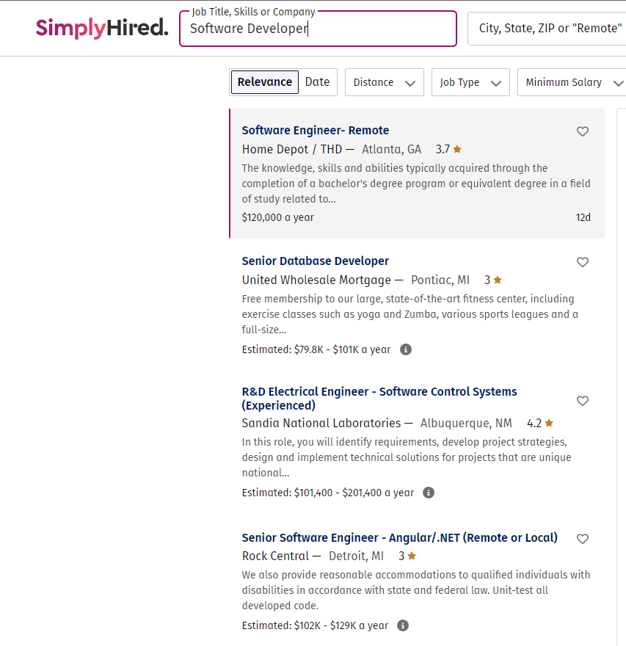
Data Collection
Job listings were scraped from two popular websites: Indeed.com and SimplyHired.com
Data was scraped by using a free google chrome extension called Web Scraper
This tool is used by first creating a Sitemap, setting up the selectors to define how the site will be navigated and extracted, and launching the Sitemap
The data is exported to an excel file. The result was about 500 jobs per concentration

Slide 8
Data Cleaning
Job titles were simplified (using regex)
Skills were separated into technical, soft, and business skills (using regex)
Skills were re-organized into lists
Data scraped from Indeed.com and SimplyHired.com was made uniform and combined

Slide 9
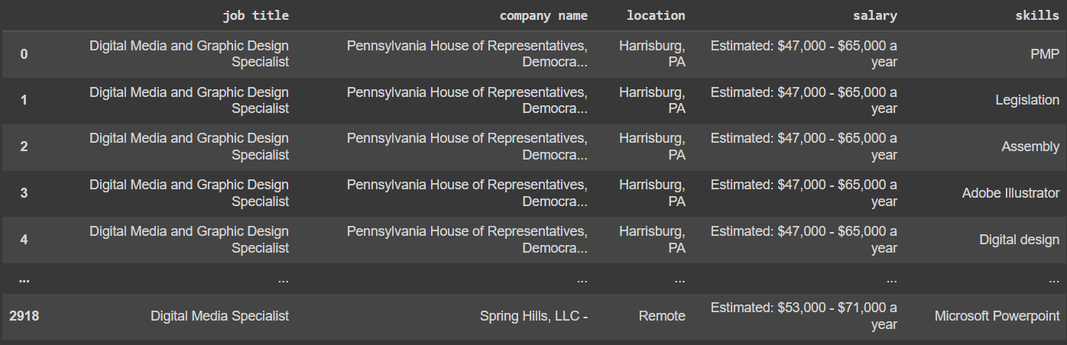
Raw Data

Slide 10
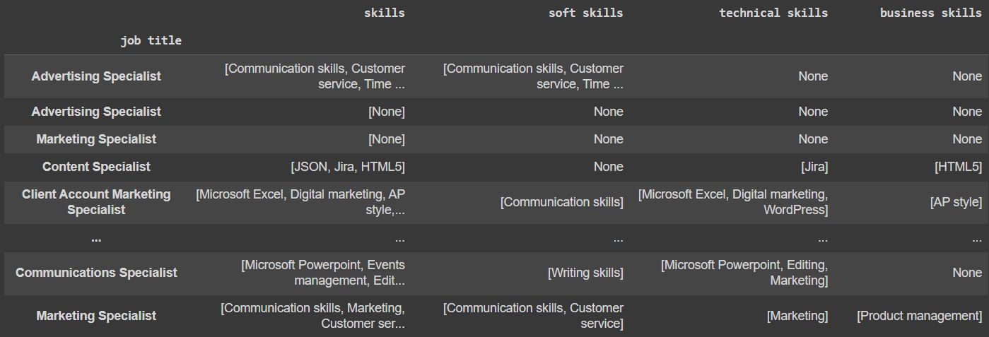
Cleaned Data

Slide 11
Data Analysis
We performed data analysis to identify the most common job titles for each IT concentration.
We then determined the most common skills for each of these job titles.
To do the above two things, we needed a method to parse each element of the list in the skills column
The next slides show our findings for the Digital Media concentrations.

Slide 12
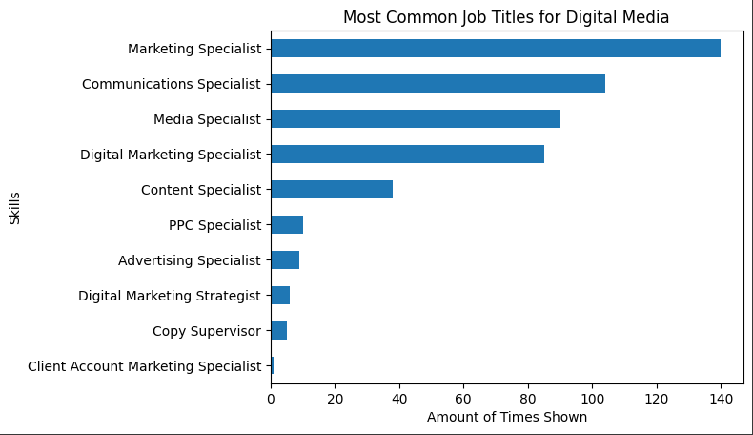
Digital Media Job Titles

Slide 13
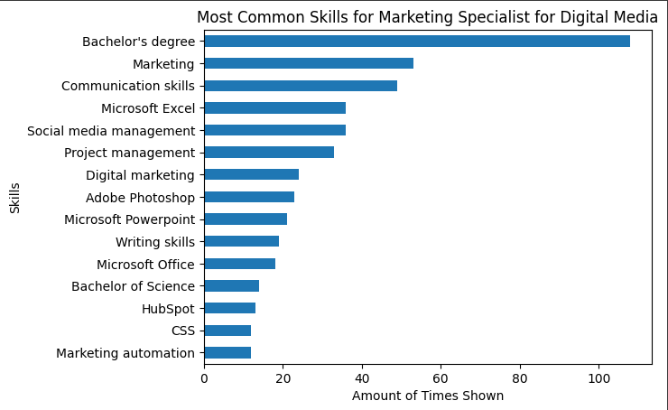
Marketing Specialist

Slide 14
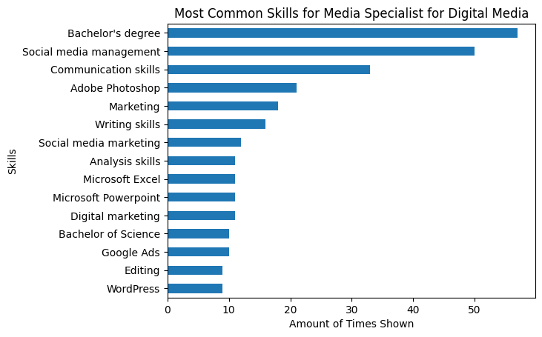
Media Specialist

Slide 15
Website Demo
https://ggc-dsa.github.io/itskills/

Slide 16
Conclusion
Our analysis offers valuable insights into current job market trends, aiding GGC students in identifying highly demanded job skills. Our web application bridges the gap between academic learning and job market demands.

Slide 17

Future Work
Modifying the survey
Conducting a survey among GGC IT students
Including courses for each skill on the Grizzly Paths website.
Continuing analysis on the three categories of skills(technical, soft, and business).

Slide 18
References
Website: https://ggc-dsa.github.io/itskills/
Github: https://github.com/GGC-DSA/itskills
Google Colab Notebook: https://colab.research.google.com/drive/1h0s2zvpImo0iT2V-4f-oap5x7Y2aX0Ym?usp=sharing

